Slide 1

Near-Realtime Intrusion Detection and Prevention system using Suricata, ELK and BGP
By Lex van Roon <lvanroon@bol.com>

Slide 2
Who am I?
Lex van Roon, SRT Retail Engineer
Hacker since 2001
Interest in Intrusion Detection since 2002
Building / Writing IDS automation systems since 2005

Slide 3
Ehhh …. Realtime whut???
System to block bad guys on the network
Works on a fully automated basis
Can be hooked up to all kinds of systems to detect intrustion attempts
Hooks into existing blocking mechanisms

Slide 4
Terms
Intrusion Detection System (IDS)
Sniffs network traffic and matches against protocol analyzers and ruleset.
Intrusion Detection and Prevention System (IDPS)
IDS with built-in blocking capabilities
Border Gateway Protocol (BGP)
Dominant routing protocol used on the internet
(source-based) Remotely Triggered Blackhole Routing (s/RTBH)
Technique of using a routing protocol to distribute ip addresses which need to be null-routed on the edge of the network

Slide 5
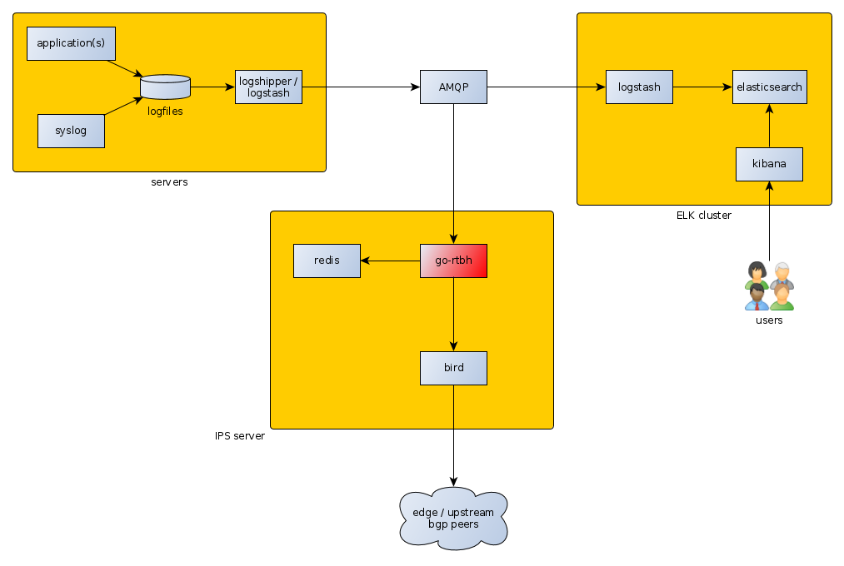
Architecture

Slide 6
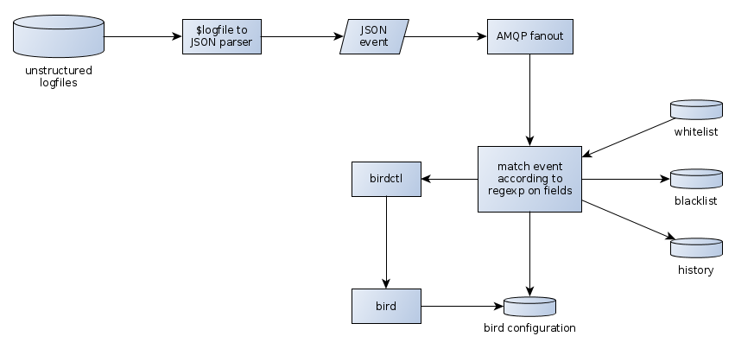
Breakdown

Slide 7
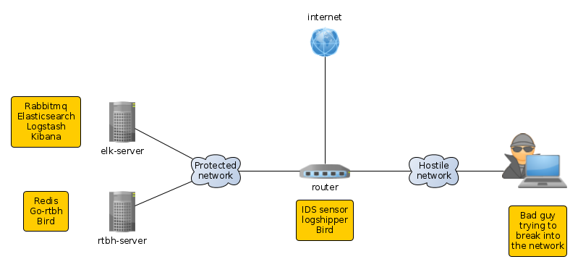
Demo network overview

Slide 8

Demo time :D

